Slide 1
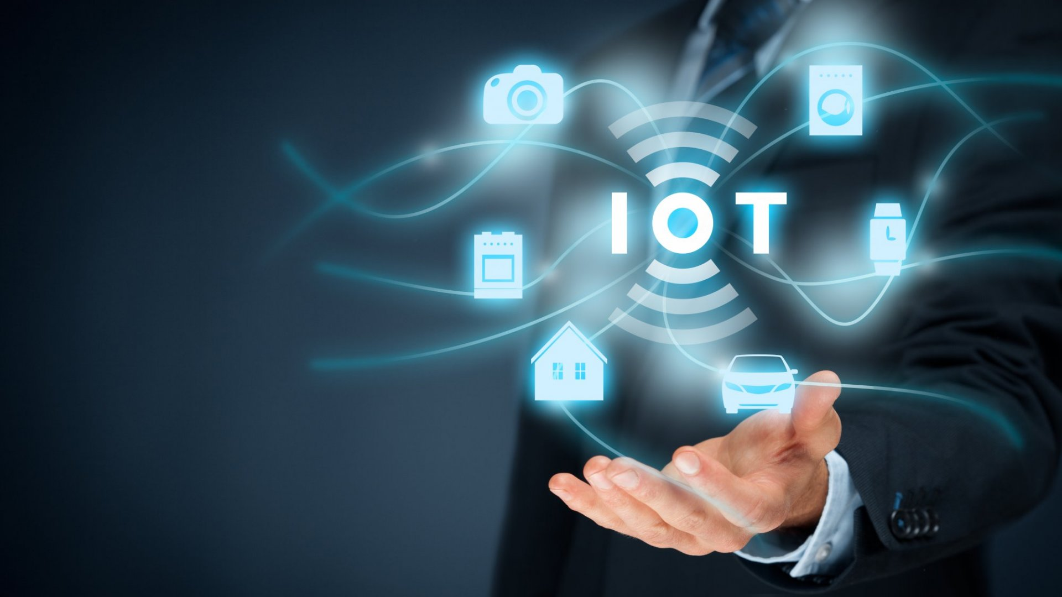
Internet of Things Fundamentals (Level-1)

Slide 2
Internet of Things Fundamentals (Level-1)
Course Code: | -- | Credits: | --
 |  | CIE Marks: | 90
Exam Hours: | 03 | SEE Marks: | 60
Course Learning Outcome (CLOs): After Completing this course successfully, the student will be able to…
CLO | Learning Outcome
CLO 1 | Define and describe IoT, its significance, and common use cases in real-world applications.
CLO 2 | Demonstrate proficiency in using IoT communication protocols (HTTP, MQTT, CoAP) for data exchange.
CLO 3 | Interface sensors and actuators with microcontrollers (e.g., Arduino) for IoT applications.
CLO 4 | Collect, analyze, and visualize IoT data.
CLO 5 | Implement IoT projects that involve cloud integration for remote monitoring and control.
CLO 6 | Troubleshoot and debug IoT systems, addressing performance and integration issues.
CLO 7

Slide 3
Summary of Course Content
Serial No. | SUMMARY OF COURSE CONTENT | Hours | CLOs
1 | Introduction to IoT, its significance, and real-world use cases | 3 | CLO 1
2 | IoT communication protocols (HTTP, MQTT, CoAP) | 6 | CLO 2
3 | Interfacing sensors and actuators with microcontrollers (e.g., Arduino) | 8 | CLO 3
4 | Data collection, analysis, and visualization in IoT | 5 | CLO 4
5 | IoT project implementation with cloud integration | 10 | CLO 5
6 | Troubleshooting and debugging IoT systems | 4 | CLO 6
7 | IoT system security and vulnerability protection | 4 | CLO 7
Textbooks:
"Internet of Things: A Hands-On Approach" by Arshdeep Bahga, Vijay Madisetti
"Getting Started with Arduino" by Massimo Banzi
Additional References:
"Arduino Cookbook" by Michael Margolis
"Building the Internet of Things" by Maciej Kran

Slide 4
Assessment Pattern
CIE- Continuous Internal Evaluation (30 Marks)
Bloom's Category Marks (out of 90) | Lab Participation (10) | Assignments (10) | Quizzes (10)
Remember |  |  | 05
Understand | 05
Apply |  | 05
Analyze | 05
Evaluate |  | 05 | 05
Create
SEE- Semester End Examination (20 Marks)
Bloom's Category | Test
Remember
Understand
Apply | 10
Analyze
Evaluate
Create | 10

Slide 5
Course Plan
Week | Topics | Teaching-Learning Strategy(s) | Class Hour | Practice Hour | Assessment Strategy(s) | Mapping with CLO
01 | Introduction to IoT: Ability to define IoT and explain its significance in modern systems. | Lecture, Demonstration, Interactive Q&A | 5h | 2h | Participation, Short Quiz | CLO 1: Define and describe IoT and its significance
02 | IoT Communication Protocols: Ability to identify and work with IoT protocols for data communication. | Lecture, Hands-on Exercises with HTTP, MQTT, CoAP | 5h | 4h | Practical Exercise, Written Test | CLO 2: Demonstrate proficiency in using IoT protocols
03 | IoT Hardware Components: Ability to choose hardware components for IoT projects. | Demonstration of sensors, actuators, and microcontrollers | 5h | 4h | Lab Participation, Practical Assignment | CLO 3: Interface sensors with microcontrollers
04 | Arduino Basics for IoT: Ability to write basic Arduino programs and interface with sensors. | Hands-on sessions with Arduino, Coding tutorials | 5h | 4h | Lab Performance, Coding Test | CLO 3: Interface sensors with microcontrollers
05 | Sensors and Actuators for IoT: Ability to select and connect sensors and actuators to microcontrollers. | Practical exercises with sensors and actuators | 5h | 4h | Hands-on Assignment, Peer Review | CLO 3: Interface sensors with microcontrollers
06 | IoT Data Collection and Basic Analysis: Ability to collect and process IoT data for analysis and visualization. | Hands-on sessions on data collection, basic analysis, and visualization tools | 5h | 3h | Data Collection Exercise, Report Submission | CLO 4: Collect, analyze, and visualize IoT data
07 | Project: Smart Temperature Monitor: Ability to integrate sensors and microcontrollers for a basic IoT project. | Guided project work: Build a temperature monitoring system | 5h | 5h | Project Progress Evaluation, Lab Report | CLO 5: Implement IoT projects with cloud integration
08 | IoT System Integration: Ability to integrate different IoT components into a functioning system. | System integration workshop, IoT component interfacing | 5h | 3h | Integration Exercise, Group Discussion | CLO 5: Implement IoT projects with cloud integration
09 | IoT Cloud Platforms: Introduction: Ability to connect IoT devices to cloud platforms for remote monitoring. | Introduction to IoT cloud platforms (AWS, Azure, Google IoT), hands-on work | 5h | 3h | Cloud Integration Exercise, Test on Cloud Tools | CLO 5: Implement IoT projects with cloud integration

Slide 6
Course Plan
Week | Topics | Teaching-Learning Strategy(s) | Class Hour | Practice Hour | Assessment Strategy(s) | Mapping with CLO
10 | IoT Security Basics: Understanding IoT security risks and implementing basic safeguards. | Lecture, Hands-on exercises on encryption and security techniques | 5h | 3h | Security Challenge, Practical Application Test | CLO 7: Apply basic security techniques to IoT systems
11 | IoT Project Integration: Ability to integrate IoT components with cloud platforms for remote control and monitoring. | Hands-on session to integrate sensors, microcontrollers, and cloud services | 5h | 4h | Practical Exercise, Integration Evaluation | CLO 5: Implement IoT projects with cloud integration
12 | Project Work: Building a Smart Device: Ability to design and implement a smart IoT system with cloud connectivity. | Guided project work, Developing a complete smart device | 5h | 5h | Project Submission, Prototype Demonstration | CLO 5: Implement IoT projects with cloud integration
13 | IoT System Testing and Debugging: Ability to debug and troubleshoot IoT systems. | Practical troubleshooting and testing sessions | 5h | 4h | Debugging Report, Lab Test | CLO 6: Troubleshoot and debug IoT systems
14 | IoT Data Management: Ability to manage and structure large volumes of IoT data. | Introduction to data management, database integration, hands-on exercises | 5h | 3h | Data Management Assignment, Practical Test | CLO 4: Collect, analyze, and visualize IoT data
15 | Final Project Development: Ability to implement a complete IoT project from start to finish. | Guided work on a final IoT project, including sensors, actuators, and cloud integration | 5h | 5h | Project Report, Final Project Evaluation | CLO 5: Implement IoT projects with cloud integration
16 | Project Presentation: Ability to effectively communicate IoT project designs and results. | Presentation preparation and peer review | 5h | 1h | Project Presentation, Peer Feedback | CLO 6: Troubleshoot and debug IoT systems
17 | Final Assessment: Evaluation of knowledge and practical skills in IoT development. | Written test, Practical assessment covering all IoT components | 5h |  | Written Exam, Lab Performance Assessment | CLO 1-7: All CLOs

